Slide 1
Modeling and implementing SuperType/SubTypes in the Relational Model

Slide 2
Emp_No
Emp_Name
EMPLOYEE
Emp_Addr
HOURLY
EMP
SALARIED
EMP
CONSULTANT
Fee
Hourly_
rate
Salary
C_Firm

Slide 3
Each employee will
Be in EMPLOYEE and
One of the subtypes
Emp_No
Emp_Name
EMPLOYEE
Emp_Addr
d
Emp_Type
“H”
“S”
“C”
HOURLY
EMP
SALARIED
EMP
CONSULTANT
Fee
Hourly_
rate
Salary
C_Firm

Slide 4
Supertype/Subtype are not directly supported in relational model
Use the following steps:
Create a table for each supertype and subtype
Attributes in common go in the supertype table
Attributes unique go into the subtype table
Include the PK of the supertype in each subtype table (as a FK)
Include a discriminator in the supertype
(an attribute that determines into which subtype an item will go )

Slide 5
Disjoint subtypes (cannot overlap):
Vehicle
VEHICLE(VIN, Make, Model, Price, V_Type)
CAR(VIN, No_Pass)
TRUCK(VIN, Cab_Type)
Discriminator
D
“C”
“T”
Car
Truck
Disjoint: A vehicle is either a Car or a Truck, but cannot be both

Slide 6
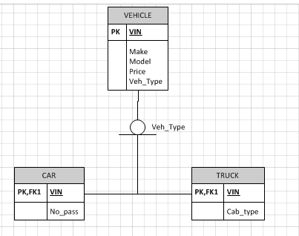
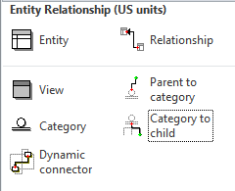
Visio Diagram:

Slide 7
Overlapping subtypes (can overlap):
Person
PERSON(PIN, First, Last, Cell, Teacher, Parent)
TEACHER(PIN, School)
PARENT(PIN, NumChildren)
O
Teacher=“Y”
Parent=“Y”
Boolean
(yes/no)
Teacher
Parent
Overlapping: A Person can be a Teacher, or can be a Parent, or
Can be both a Teacher and a Parent

Slide 8
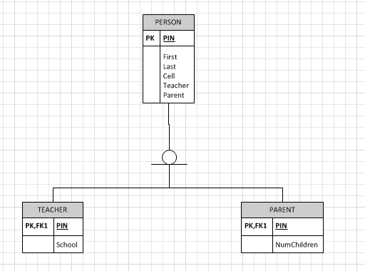
Visio Diagram

